Slide 1
ECE 157B Section
Homework 4.2
Text Processing
Part 2: Transformers & BERT
University of CA, Santa Barbara

Slide 2
Overview
Preprocessing Text for Transformers
Load and preprocess text data
Load & explore pre-trained tokenizers (vectorizers)
Transformer Networks
Architecture review
BERT
pre-trained model hub
task “heads”

Slide 3
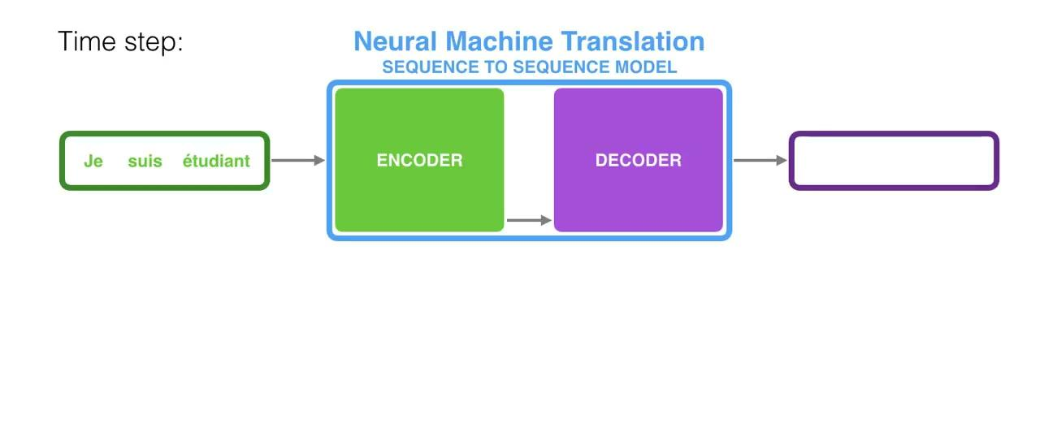
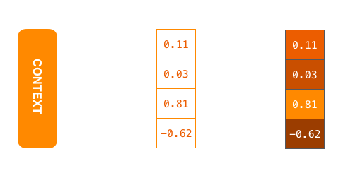
Seq2Seq
The encoder compiles the information it captures into a vector (called the context)
Context vector

Slide 4
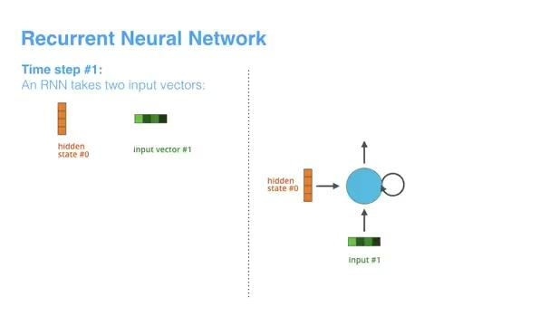
Recall RNN
Notes:
The next RNN step takes the second input vector and hidden state #1 to create the output of that time step

Slide 5
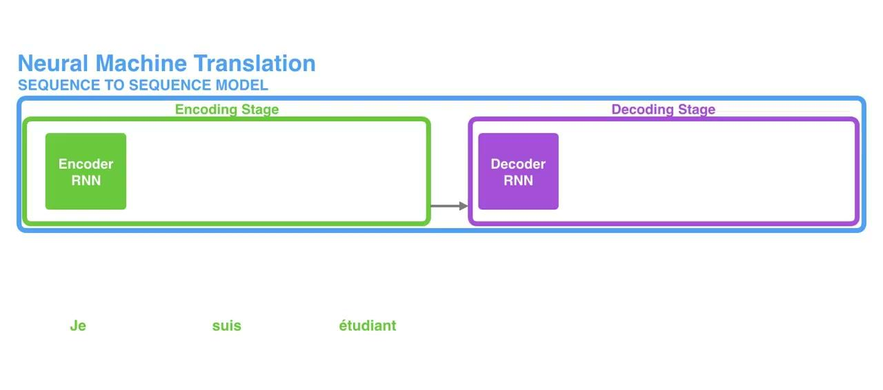
RNN for Seq2Seq (Unrolling)
Encoder passes the last hidden state to decoder

Slide 6
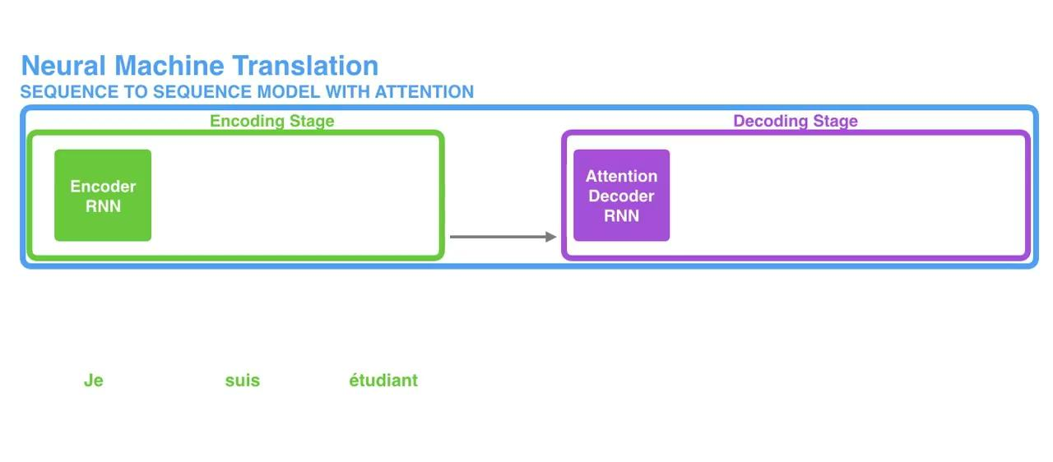
Attention
The encoder passes all the hidden states to the decoder
An attention decoder focus on the relevant parts of the input sequence as needed

Slide 7
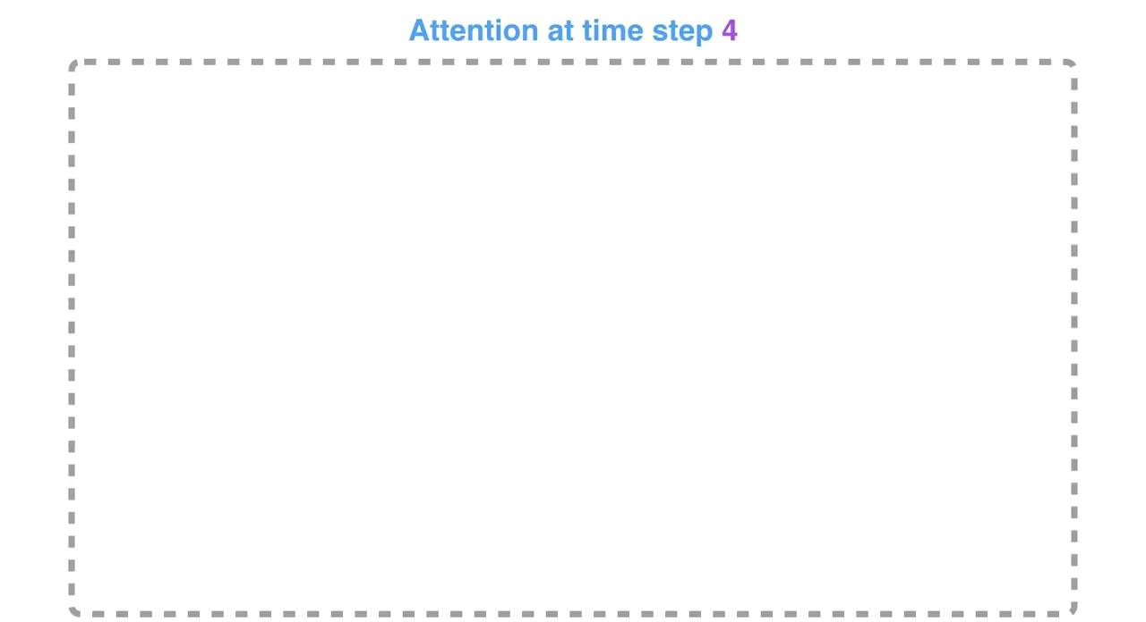
Attention Process
Notes:
This scoring exercise is done at each time step on the decoder side.
Let us now bring the whole thing together in the following visualization and look at how the attention process works:
The attention decoder RNN takes in the embedding of the <END> token, and an initial decoder hidden state.
The RNN processes its inputs, producing an output and a new hidden state vector (h4). The output is discarded.
Attention Step: We use the encoder hidden states and the h4 vector to calculate a context vector (C4) for this time step.
We concatenate h4 and C4 into one vector.
We pass this vector through a feedforward neural network (one trained jointly with the model).
The output of the feedforward neural networks indicates the output word of this time step.
Repeat for the next time steps

Slide 8
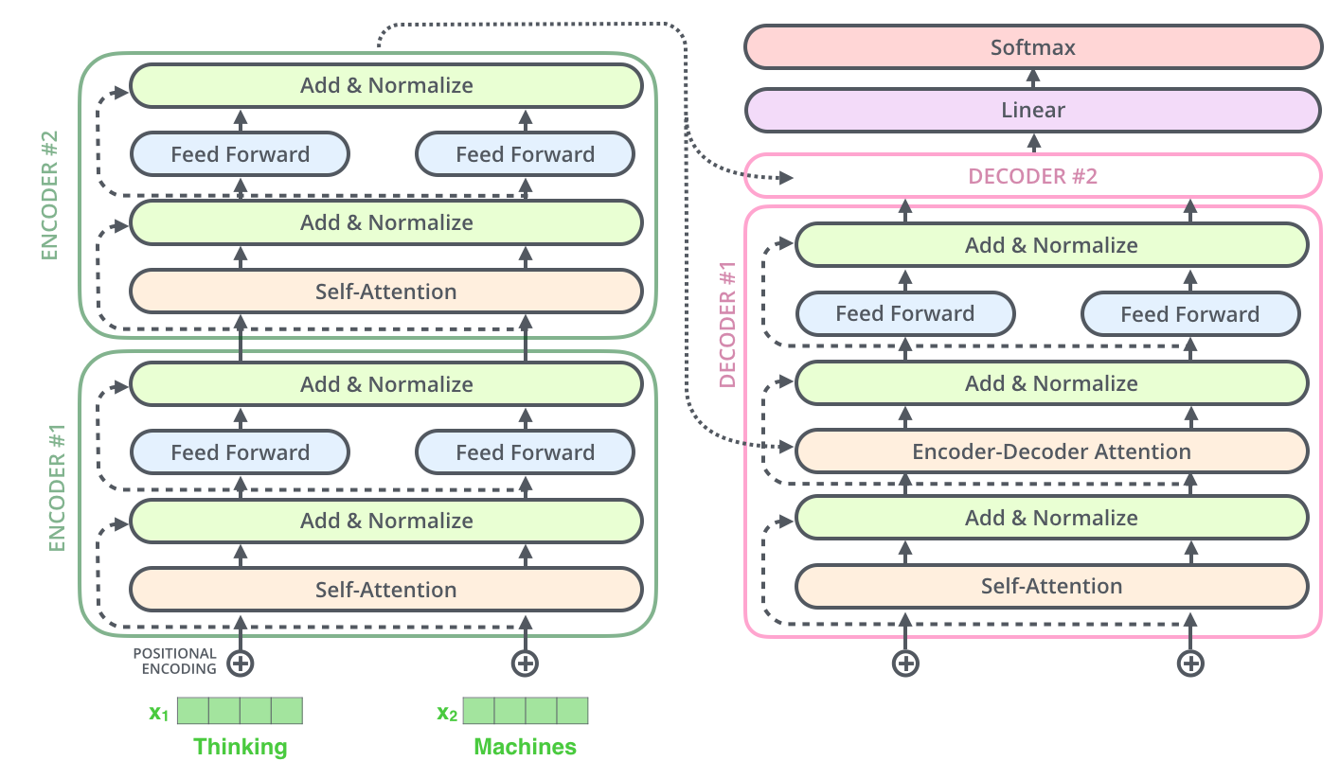
Transformers - Attention is All You Need!

Slide 9
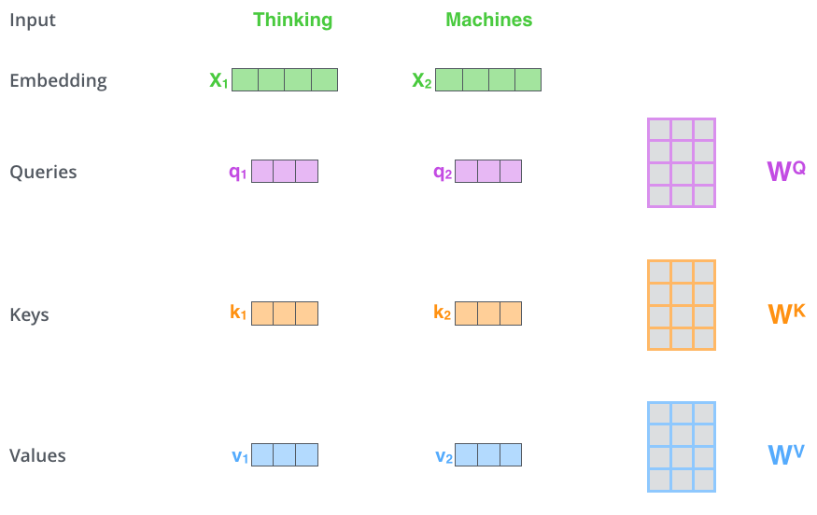
Self-Attention in Detail
Create a "query", a "key", and a "value" projection of each word in the input sentence.

Slide 10
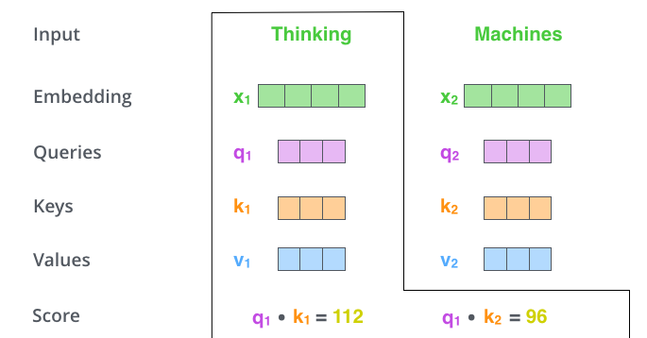

Slide 11
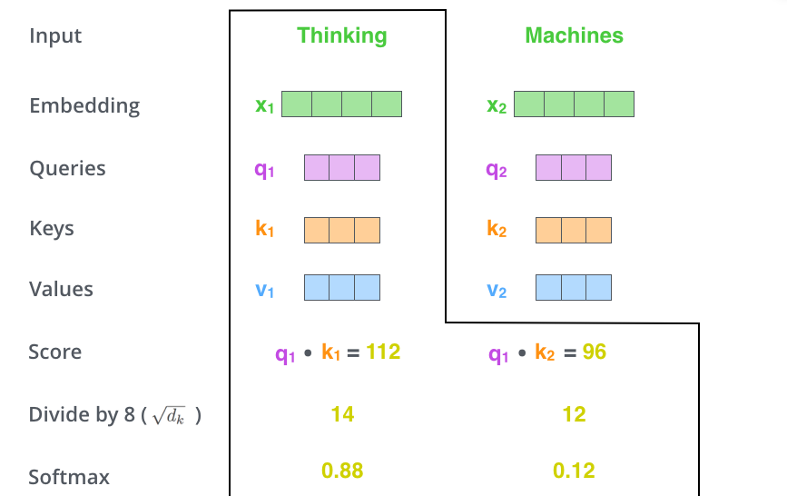

Slide 12
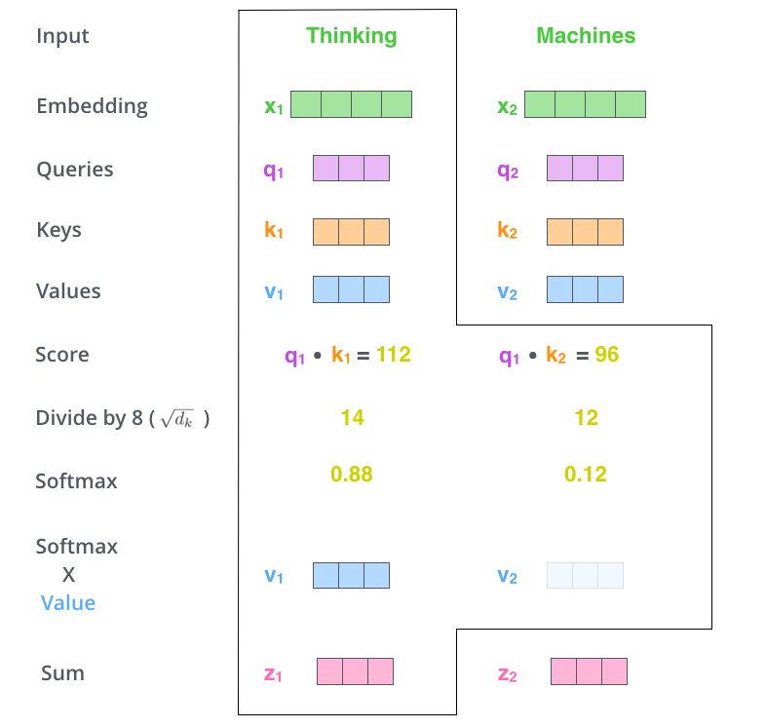

Slide 13
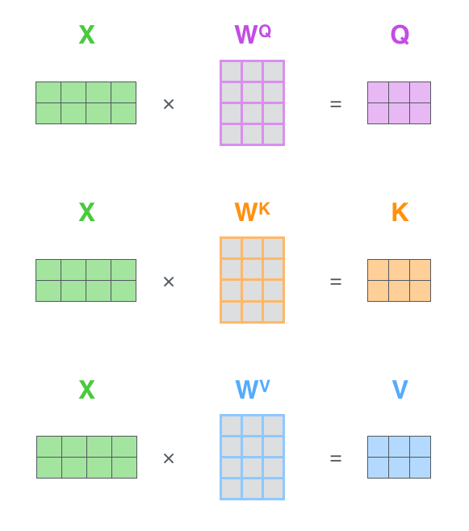

Slide 14
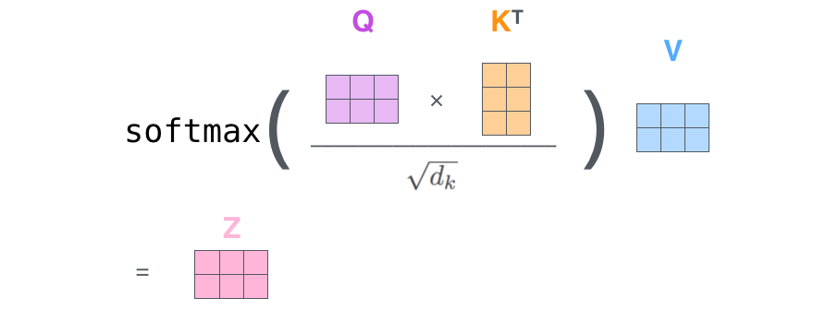

Slide 15
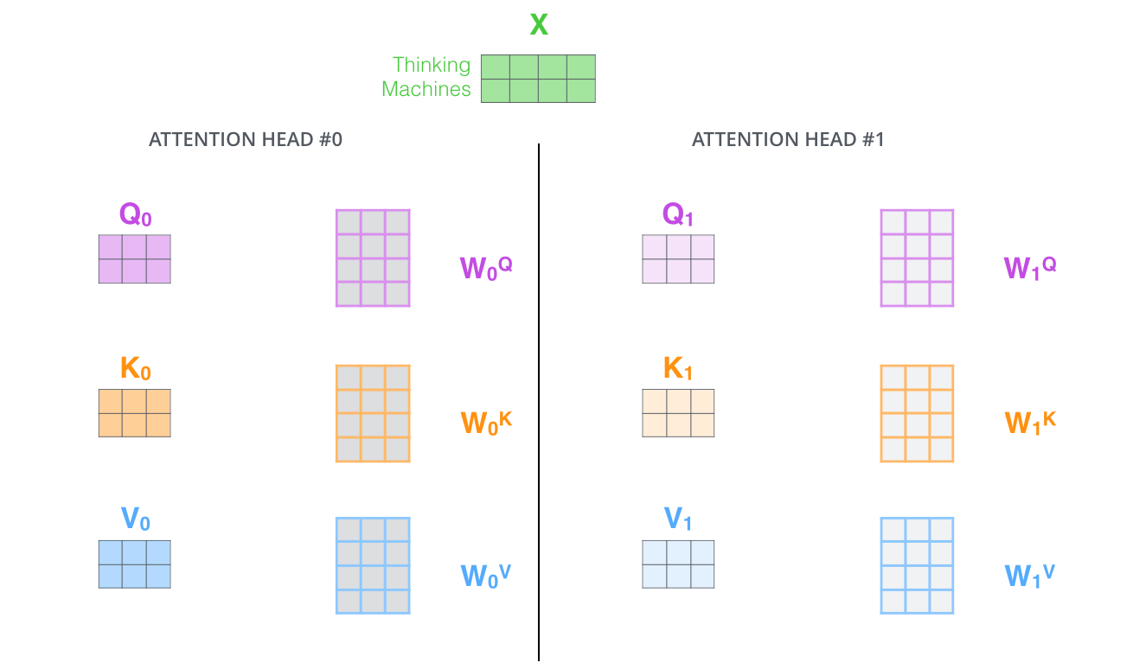

Slide 16
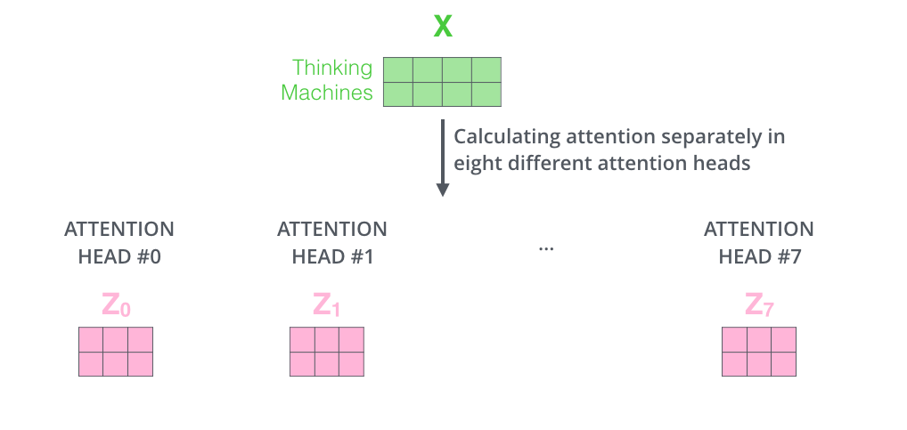

Slide 17
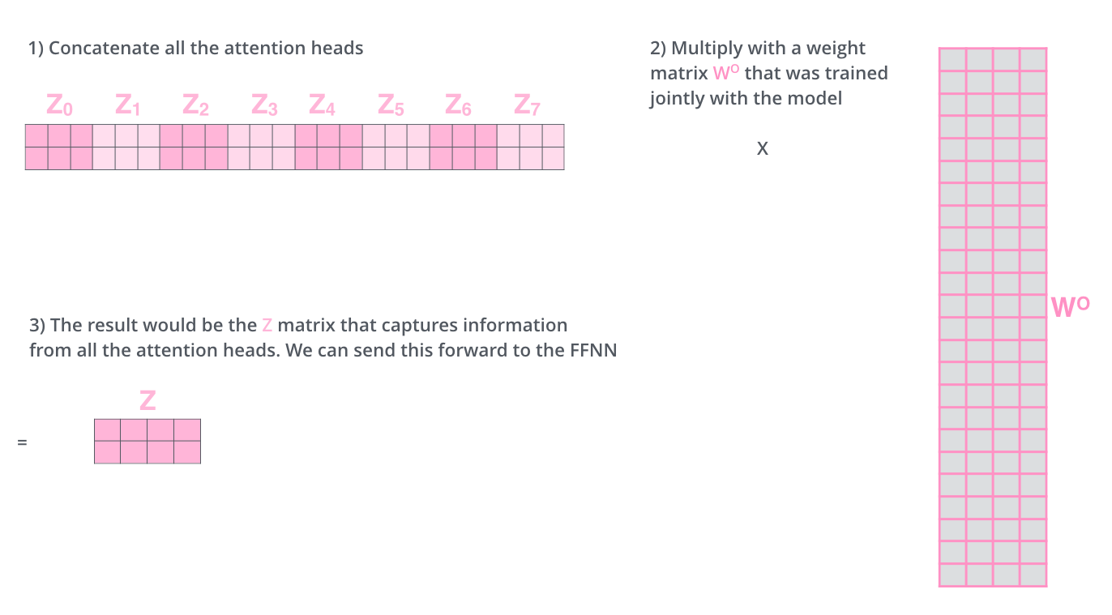

Slide 18
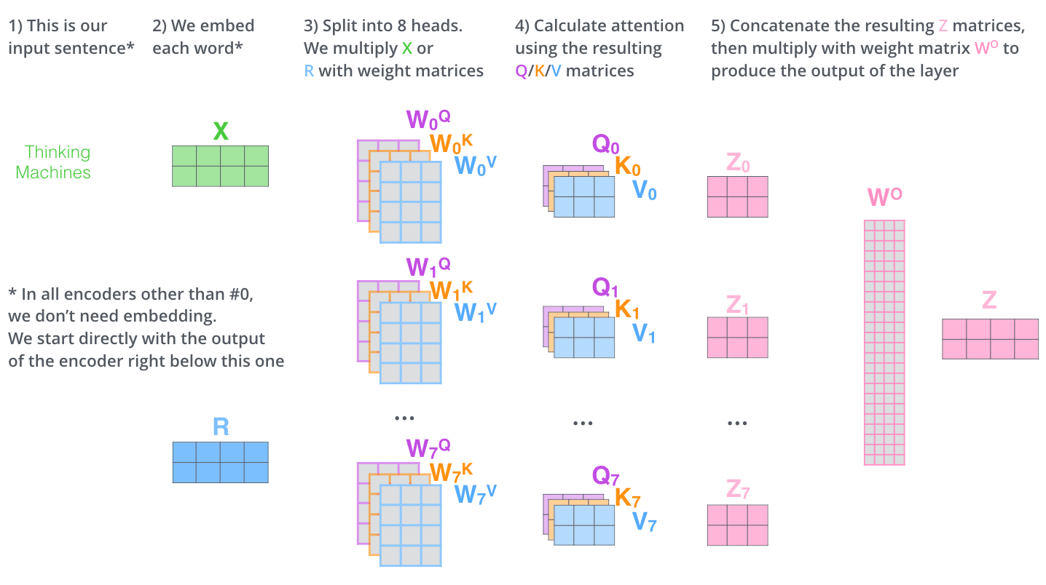
Attention Summary

Slide 19
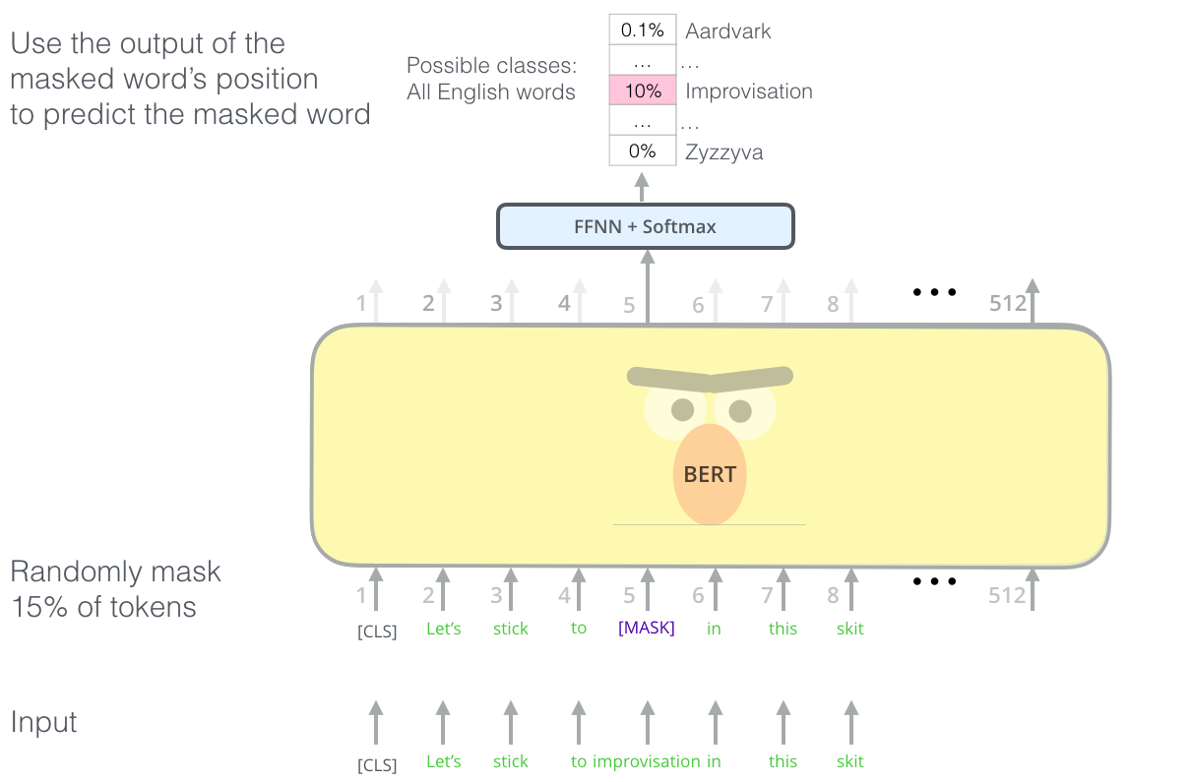
Bert: From Decoders to Encoders
https://jalammar.github.io/illustrated-bert/

Slide 20
“Heads”
Foundation Models put a lot of effort into their basic tasks on lots of data.
Once they’re done, to retain information they only throw away the last bit - the “head”
Specific Head (like classification)
Pre-training Head
BERT
BERT
Pre-training Task (masking)
Wikipedia
Specific data

Slide 21
“Heads”
Foundation Models put a lot of effort into their basic tasks on lots of data.
class
Mask words
Specific Head (like classification)
Without the head, BERT is just generating context-dependent embeddings
Pre-training Head
e
e
e
BERT
BERT
BERT
Wikipedia
Specific data
e
e
e
any text

Slide 22
“Heads”
Foundation Models put a lot of effort into their basic tasks on lots of data.
In transformers, they make it easy to choose a head. However, you have to make sure that either the version you load has been trained, or you train it yourself!
AutoModelForPreTraining
AutoModelForMaskedLM
class
AutoModelForSequence-
Classification
AutoModel
Mask words
Specific Head (like classification)
Without the head, BERT is just generating context-dependent embeddings
Pre-training Head
BERT
BERT
BERT
Wikipedia
Specific data
any text

Slide 23
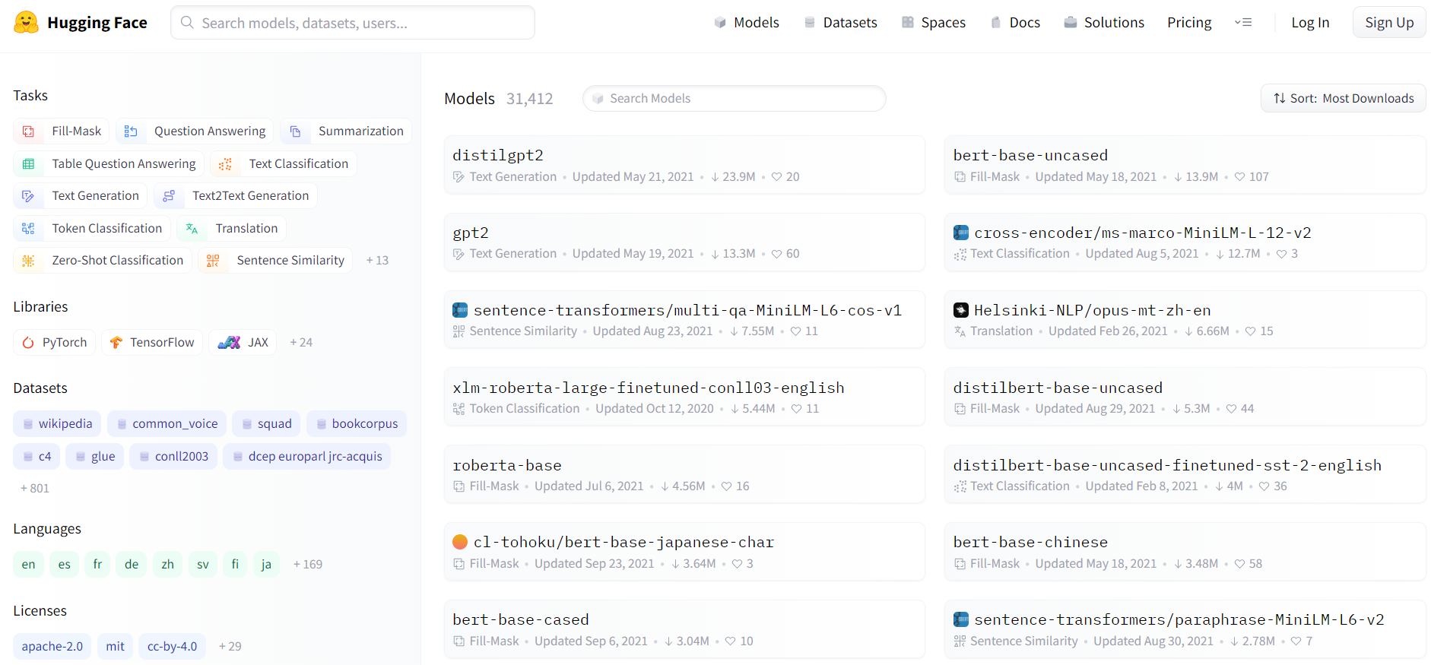
HuggingFace
Thousands of pre-trained models, and easy access to load or initialize new heads. bert-base-uncased · Hugging Face

Slide 24
Time for…
Questions?
(Before moving onto coding examples)

